Slide 1
William Shakespeare
An author or only a person?

Slide 2
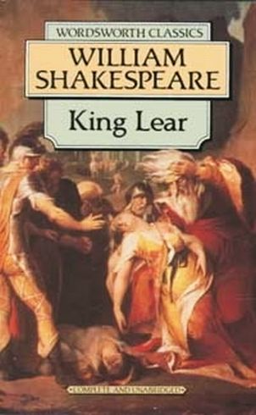
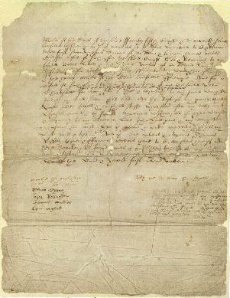
Shackspeare and Shakespeare
There are some different between these persons.

Slide 3
In the name of god Amen I William Shackspeare, of Stratford upon Avon in the countrie of Warr., gent., in perfect health and memorie, God be praysed, doe make and ordayne this my last will and testament in manner and forme followeing, that ys to saye, ffirst, I comend my soule into the hands of God my Creator, hoping and assuredlie beleeving, through thonelie merites, of Jesus Christe my Saviour, to be made partaker of lyfe everlastinge, and my bodye to the earth whereof yt ys made. Item, I gyve and bequeath unto my daughter Judyth one hundred and fyftie poundes of lawfull English money, to be paid unto her in the manner and forme foloweng, that ys to saye, one hundred poundes in discharge of her marriage porcion within one yeare after my deceas, with considera cion after the rate of twoe shillings in the pound for soe long tyme as the same shalbe unpaied unto her after my deceas, and the fyftie poundes residwe thereof upon her surrendring of, or gyving of such sufficient securitie as the overseers of this my will shall like of, to surrender or graunte all her estate and right that shall discend or come unto her after my deceas, or that shee nowe hath, of, in, or to, one copiehold tenemente, with thappurtenaunces, lyeing and being in Stratford upon Avon aforesaied in the saied countrye of Warr., being parcell or holden of the mannour of Rowington, unto my daughter Susanna Hall and her heires for ever.

Slide 4
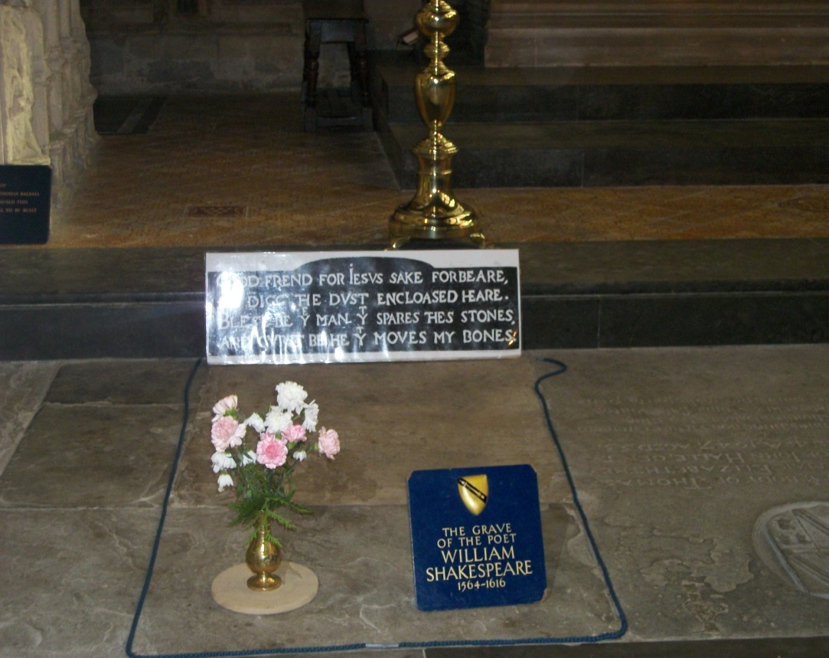
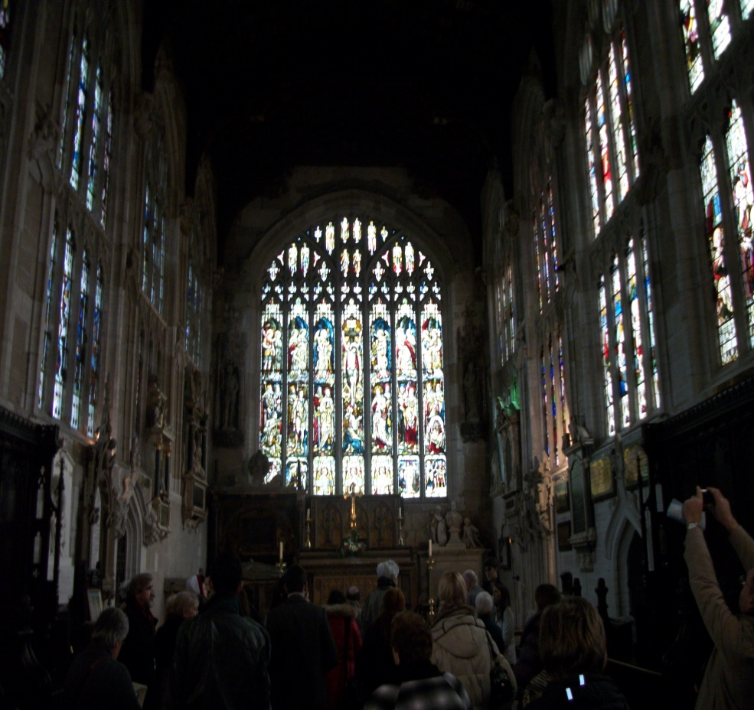

Slide 5
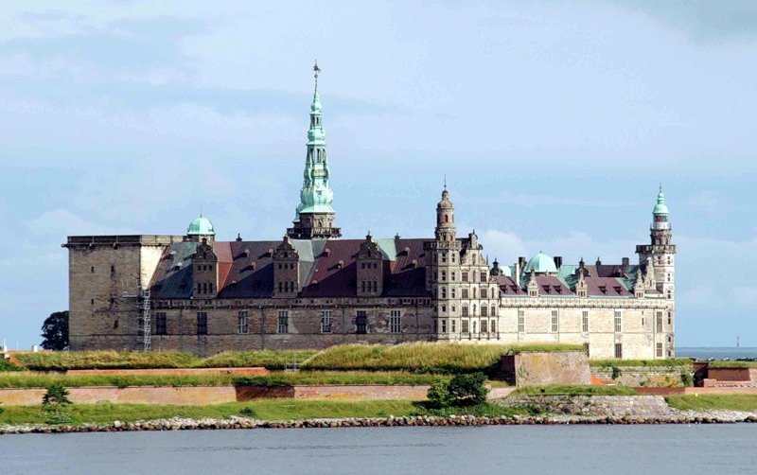
In his plays William described Denmark castles. But in fact he has never been there.
For example in Hamlet

Slide 6
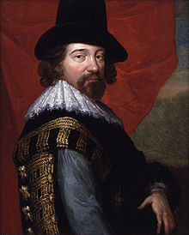
Francis Bacon theory
Francis Bacon was very important person in those times. Between his students of the same year were Rosenkranz and Guildenstern. And they were also from Denmark.

Slide 7
Thanks for your attention!

