Slide 1
Nile Olden Armstrong
was born on August, 5th, 1930
in the USA
in the city of Uapakoneta
the State of Ohio

Slide 2
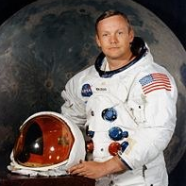
Nile Armstrong has made a reservation at disembarkation to the Moon

Slide 3

The astronaut Nile Armstrong has passed an indefinite article in the well-known phrase said after disembarkation to the Moon. As informs BBC News, to such conclusion researchers have come on the basis of the newest linguistic analysis. According to scientists, the astronaut has made a reservation for excitement, and its phrase has turned out not quite true, but poetical.

Slide 4

"It is one small step for the person, but huge jump for all mankind", - so the phrase of the astronaut in a classical variant sounds. As researchers, actually Armstrong have established has passed an article "a" before a word man ("person"). Because of it initially conceived meaning - "a step for one person" is lost - and without an article a word "person" becomes a book synonym of a word "mankind".

Slide 5

Assumptions of that Armstrong, the first stepped into the Moon surface, has not uttered an article, appeared and before, and the phrase was published in different variants. Thus Armstrong and NASA explained that the article - irrespective of, has sounded it or not, - was meant. Last conclusion of researchers unequivocally testifies for the first time that the reservation took place, so - the well-known phrase has not been prepared in advance and was born spontaneously.

Slide 6
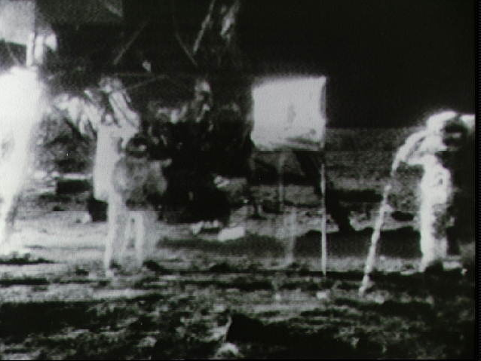
The American ship "Apollo-11" delivered astronauts to the Moon on June, 24th, 1969. Soon after Armstrong, the commander of crew, on a planet surface there was a pilot of lunar module Edvin Oldrin. The third member of team, Michael Collins, remained in a lunar orbit.

Slide 7
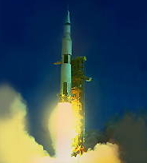
Start of a spaceship "Apollo".

Slide 8
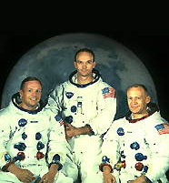
"Apollo-11" crew.

Slide 9
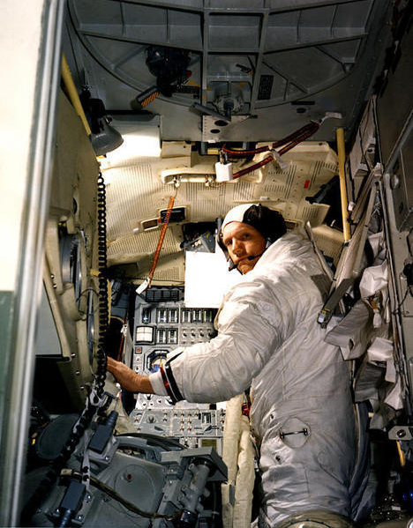
And here Armstrong in "Apollo-11"

Slide 10
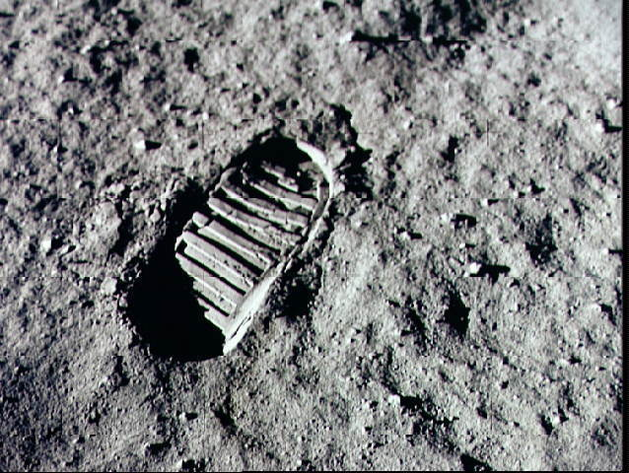
It is a trace which Nile Armstrong has left on the moon

Slide 11
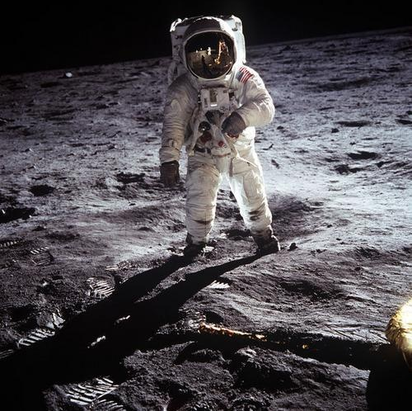
Armstrong on the moon

Slide 12
All time while cosmonauts were on the Moon, there was a direct transmission almost worldwide. After Nile Armstrong has returned to the Earth, it has left NASA. Now he lives with the wife and children in the State of Ohio, being engaged in family business.

Slide 13

THE END

